Slide 1
Part III
Elementary Statistical Methods
Probability

Slide 2
Elementary Statistical Methods
Chapter 5
Discrete Probability Distributions
Slides are Made by
Tamer Oraby
UTRGV

Slide 3
Outline:
Random variables: Discrete - Continuous.
Discrete probability distribution & probability histogram.
Mean, variance and standard deviation of a random variable X.
Binomial distribution as an example of a discrete probability distribution.

Slide 4
Random variable: (X, Y, Z, …)
is a numerical outcome of a random experiment
has a ″countable″ number possible values x
Examples: x = 0, 1, 2, 3
x = 1, 2, 3, …
has an ″uncountable″ number of possible values x
Examples: 0 < x <1
0 < x <∞
Discrete
Continuous
In this chapter,
we will focus
on discrete
random
variables.
Next chapter.

Slide 5
Example :
Flip a coin three times
S={HHH, HHT, HTH, THH, TTH, THT, HTT, TTT}
Define the random variable
X: Number of heads appear
x | In case of | P(x)
0 | T T T | 1/8
1 | HTT, THT, TTH | 3/8
2 | HHT, THH, HTH | 3/8
3 | HHH | 1/8
 | Total | 1
Total
Discrete Probability Distribution

Slide 6
5.1 Discrete Random Variable.
Probability Distribution:
given in a table, graph, or a mathematical formula.
Probability distribution function ( pdf )
gives possible values x and their probabilities P(x) such that:
probabilities are between zero and one.
&
sum of all probabilities is equal to ONE.

Slide 7
Example :
Flip a coin three times
X: Number of heads appear
(a) What is the probability that exactly two heads appear?
x | P(x)
0 | 1/8
1 | 3/8
2 | 3/8
3 | 1/8
Total | 1
(b) What is the probability of more than one head appear?

Slide 8
(c) What is the probability of at most two heads appear?
x | P(x)
0 | 1/8
1 | 3/8
2 | 3/8
3 | 1/8
Total | 1
(d) What is the probability of at least one head to appear?
Or simpler by

Slide 9
Remarks:
Probability X is exactly x = P( X = x)=P(x) which is the pdf
Probability X is at most x = Probability X is x or less =
Probability X is no more than x = P( X ≤ x)
This function
F(x)= P( X ≤ x)
is called cumulative distribution function (cdf)
Probability X is at least x = Probability X is x or more=
Probability X is no less/fewer than x = P( X ≥ x)
Probability X is less than x = P( X < x)
Probability X is more than x = P( X > x)

Slide 10
Remarks:
By the complement rule
P (A) = 1 – P (A^{c})
P( X > x) = 1- P( X ≤ x)
P( X ≥ x) = 1- P( X < x)
= 1- P( X ≤ x-1)
Only for discrete random variables

Slide 11
Example :
Consider the following pdf of
A random variable X
x | P(x)
1 | 0.1
2 | ?
3 | 0.15
4 | 0.55
5 | 0.15
Total | 1
(a) What is the probability of X is 2, or P(2)?
P(2)=1-(0.1+0.15+0.55+0.15)=0.05
(b) What is the probability that X is at most 2?
(c) What is the probability that X is less than 2?

Slide 12
Example: (Cont’d)
Consider the following pdf of
A random variable X
x | P(x)
1 | 0.1
2 | 0.05
3 | 0.15
4 | 0.55
5 | 0.15
Total | 1
(d) What is the probability of that X is at least 2?

Slide 13
How to present the pdf in a graph?
By a Probability Histogram
3/8
3/8
x | P(x)
0 | 1/8
1 | 3/8
2 | 3/8
3 | 1/8
Total | 1
1/8
1/8
Where to place that wedge on the x axis to balance out the histogram?
Where is the center of balance?
How much does X spread/varry around the center?

Slide 14
Mean (Expected value/number of X):
is a measure of center
$$μ=E\left(X\right)=\sum_{x}{x⋅P(x)}$$
Sometimes we call it
mu
and has the same units as X
Variance:
is a measure of variation and spread
$$σ^{2}=Var\left(X\right)=\sum_{x}{(x−μ)^{2}P(x)}$$
Sigma-squared
Sometimes we call it
and has units-squared
Standard deviation:
is another measure of variation and spread
Sometimes we call it
Sigma
and has the same units as X
Remark:
$$standard deviation=\sqrt{variance}$$
$$variance={(standard deviation)}^{2}$$

Slide 15
Using Calculator TI-84 Plus
Data entry
Press [STAT] key
Choose [Edit…]
Enter x into list 1 [L1] and p(x) into list 2 [L2]
Statistics calculations
Press [STAT] key
Choose [CALC]
Choose option 1: [1-Var Stats]
List: L1
FreqList: L2 by pressing [2ND] [2]
On some calculators you do
1-Var Stats L1 , L2

Slide 16
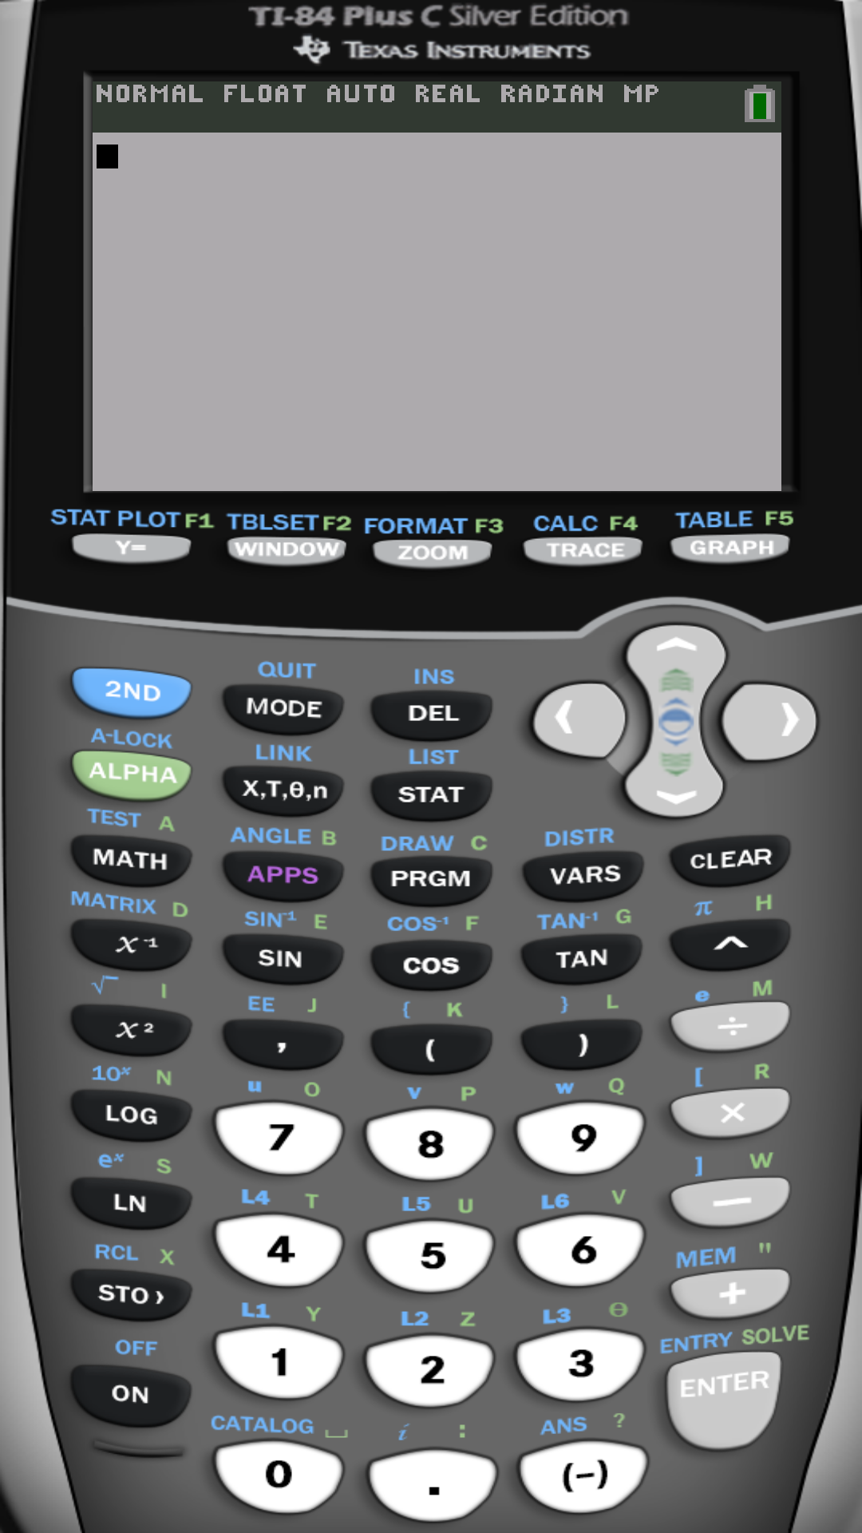
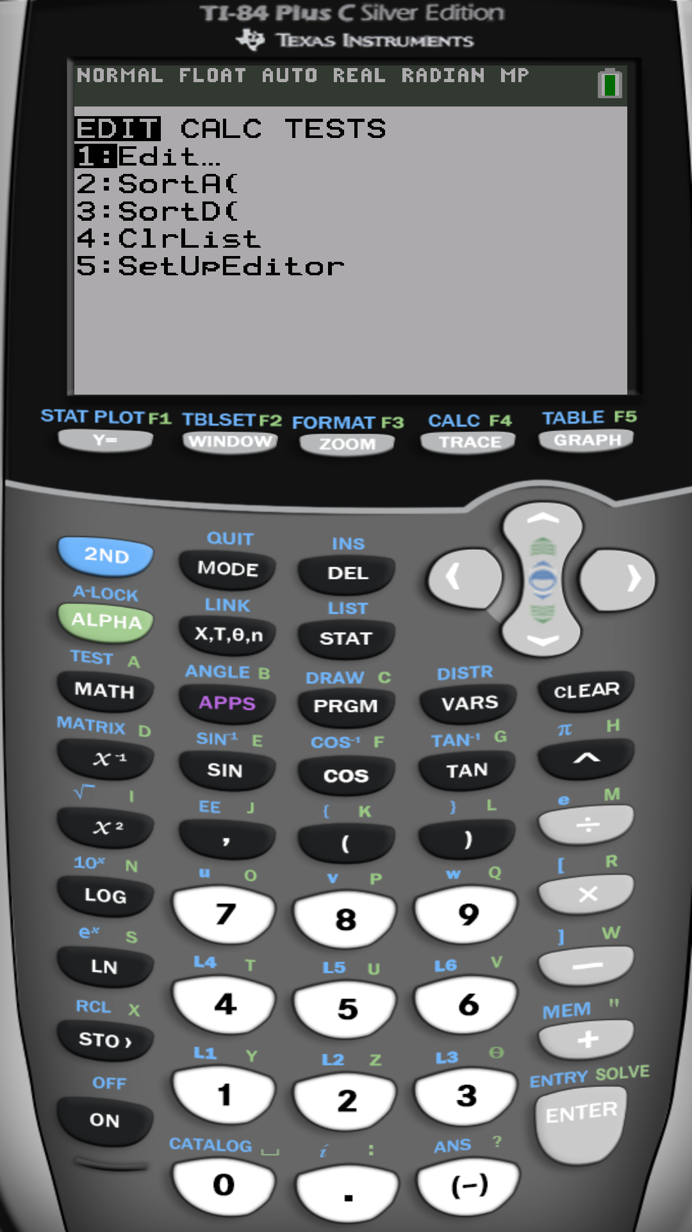

Slide 17
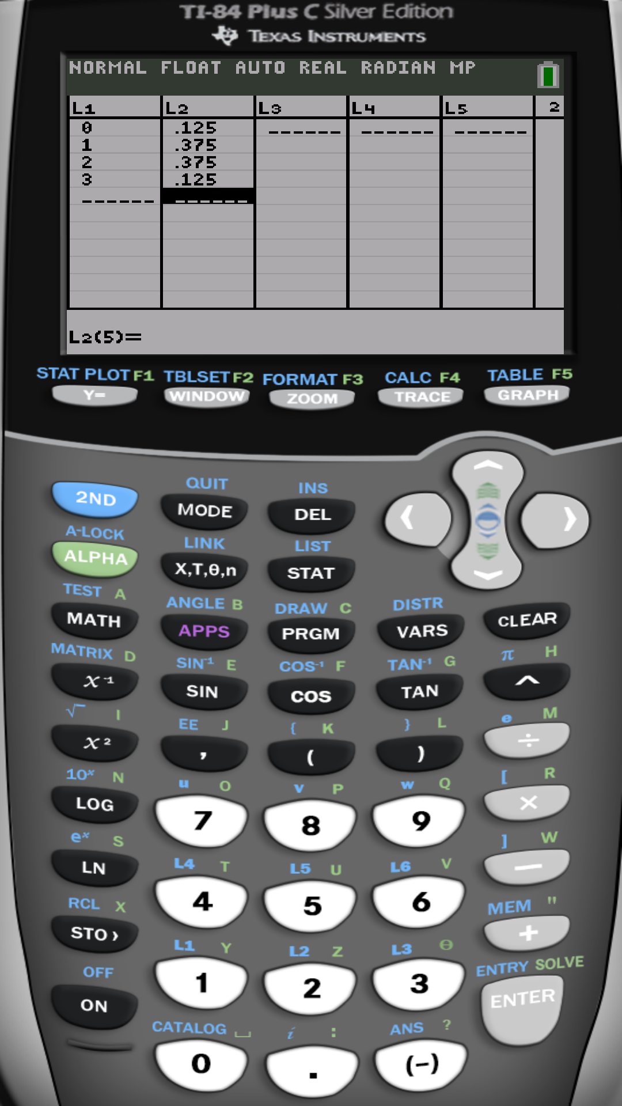
For the same example:
x | P(x)
0 | 1/8
1 | 3/8
2 | 3/8
3 | 1/8

Slide 18
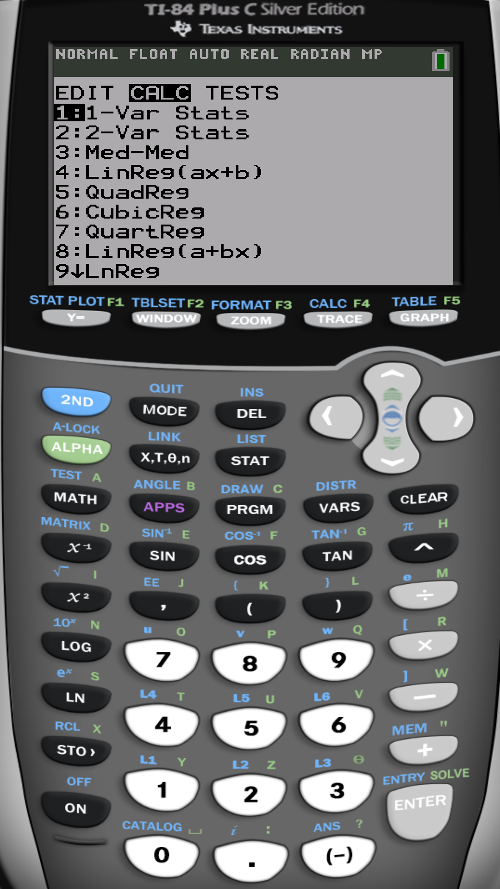

Slide 19
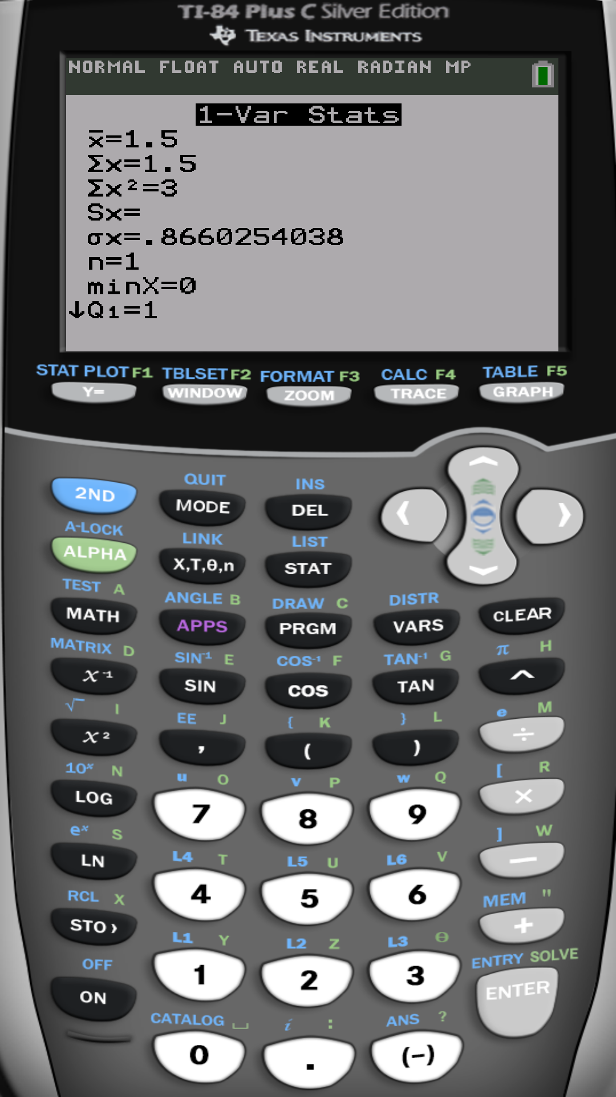
The mean or expected number of heads
The standard deviation of number of heads
The variance of number of heads

Slide 20
3/8
3/8
x | P(x)
0 | 1/8
1 | 3/8
2 | 3/8
3 | 1/8
Total | 1
1/8
1/8
$$μ=1.5$$
The center of balance is at the mean $μ=1.5$.

Slide 21
Remark:
Standard deviation measures amount of spread around the center
of X
of Y
3/8
3/8
3/8
3/8
1/8
1/8
1/8
1/8
1.2 1.4 1.6 1.8
X has more variability around the center than Y does

Slide 22
Binomial distribution as an example of a discrete probability distribution

Slide 23
5.2 Binomial Probability Distribution
Binomial random experiment:
A number n of independent trials or random selections.
Each trial results is either success (S) or fail (F).
Probability of success on any single trial is p=P(S). (P(F)=1-P(S))
X: count or number of successes (S) in the n independent trials.
Then, we say that X follows Binomial distribution with parameters n, p
X ~ Binomial(n, p)
for x = 0, 1, 2, …, n

Slide 25
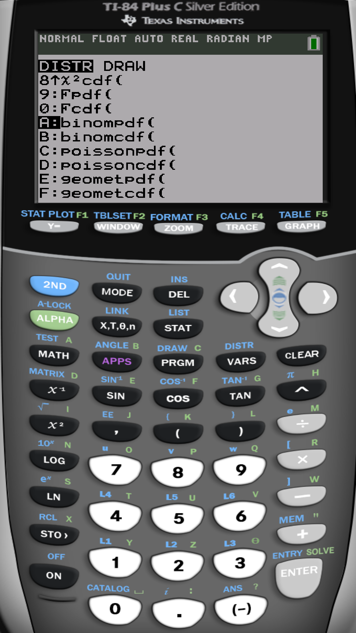
To find
P(x)=P(X = x)
p
n
x
=binompdf(n, p, x)

Slide 26
To find
F(x)=P(X ≤ x)
p
n
x
=binomcdf(n, p, x)

Slide 27
Using Calculator TI-84 Plus
Press [2ND] [VARS]
Choose A: binompdf(n,p,x) ≡ P(X = x)
or
4. Choose B: binomcdf(n,p,x) ≡ P(X ≤ x)

Slide 28
If X ~ Binomial(n, p)
Mean (Expected value/number of X):
Variance:
Standard deviation:
that is
$$standard deviation=\sqrt{variance}$$

Slide 29
Example :
On DNA chain of length n= 20 we randomly allocate either Pyrimidine (T,C) or Purine (A,G) independently with probability 0.7 and 0.3, respectively.
(a) What is the probability distribution of number of Pyrimidine on the chain?
X: number of Pyrimidine on the chain n = 20
X ~ Binomial(20, 0.7)
$$P\left(x\right)= {{}_{20}^{}C}_{x} {0.7}^{x} {0.3}^{20−x} ;x=0, 1, 2, …, 20.$$

Slide 30
(b) What is the probability that the chain has 15 Pyrimidine?
P(X =15) =?
P(X =15) = binompdf (20,0.7,15) = 0.1788

Slide 31
(c) What is the probability that the chain has at most 15 Pyrimidine?
P(X ≤ 15) = ?
P(X ≤ 15) = binomcdf (20,0.7,15) = 0.76249

Slide 32
(d) What is the probability that the chain has more than 12 Pyrimidine?
P(X > 12) = 1- P(X ≤ 12) = 1- binomcdf (20,0.7,12) = 0.772271
(e) What is the expected number Pyrimidine on the chain?
(f) What is the standard deviation of the number of Pyrimidine on the chain?

Slide 33
Using the statistical software R
R is a free professional statistical software
Download and install for free from
https://www.r-project.org/
Free on-line R compiler
http://rextester.com/l/r_online_compiler

Slide 34
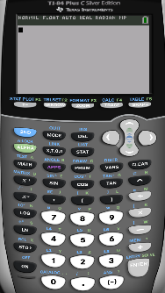
Example: If X ~ Binomial(20, 0.7)
P(X =15) = binompdf (20,0.7,15) = 0.1788 | > dbinom(15,20,0.7) [1] 0.1788631
P(X ≤ 15) = binomcdf (20,0.7,15) = 0.76249 | > pbinom(15,20,0.7) [1] 0.7624922

Slide 35
End of Chapter 5

